Slide 1
FAKE NEWS EXPOSURE USING MACHINE LEARNING
SOORYA V
NCE18MCA003
NCERC

Slide 2
Introduction
One of the main sources of news content that people rely nowadays upon is via social media. Upon the release of a new data source, there are a set of issues associated with it.
The rise of social media as a news source has the issue of generation and widespread of falsified information.
This poses a threat not only specific to a platform in which the news content is published but also to the Internet as a source of medium for communicating news as a whole
In this project, we are trying to implement a proactive methodology to predict fake news that prevalent in social media.

Slide 3
Existing system
current problem statement of this research revolves around implementing a system which would proactively measure the truthfulness of the news content that is published in the social media. The necessity of the system is to truncate the rapid spread of the falsified information that pose a threat to social media as a platform.
The main factors that are involved in the social media news ecosystem are the news articles and the users (publishers, readers etc). In this ecosystem, once the news content is published, the news is not only validated against the authenticated sources, but also the other users engagement, the publisher bias towards the published news topic and the historical credibility values of the user is taken into consideration to a more justifiable classification of the news content.

Slide 4
Proposed system
Most of the current research in the field of fake news detection use supervised means to classify the news as either fake or real. This involves training a classification model based on a predefined labeled dataset. Though these methods show significant results, they suffer a major drawback i.e. they require a reliably annotated dataset to train a classification model.
This process is time-consuming and labor intensive as it requires careful checking of news contents as well as other additional evidence such as authoritative reports. In order to mitigate this issue, the authors of the paper propose an unsupervised learning framework, to identify the fake news. The key idea involves extracting users’ opinions on the news by exploiting the auxiliary information of the users’ engagements with the news tweets on social media and aggregating their opinions in a well-designed unsupervised way to generate the final estimation results

Slide 5
Module description
Data Preprocessing: data preprocessing includes the process of stemming,stopward removal and tokanization in the dataset
Derive Relationships:establishing relationships among the news articles that can be leveraged by classification model. The relationship between the news articles was established using a graph data structure.
Feature Extraction:For the fake news detection, the actual news data (body of the news article) is being considered as features.
Training Classification Model: training classification model by using dataset.

Slide 6
Hardware Specification
System : Pentium Dual Core.
Hard Disk : 120 GB.
Monitor : 15’’ LED
Input Devices : Keyboard, Mouse
Ram : 1GB.
Software Specification
Operating system. : Windows
Coding Language : Python,Pandas,Numpy,Matplot,Sklearn
Tool : IDLE(Python) Or Anaconda

Slide 7
SCOPE OBJECTIVE
Once a source is labeled as a producer of fake news.we can predict with high Confidence that any article from that Source will also be fake
To identify the Fake news using data mining Perspective
To learn and apply the various Machine Learning algorithm
To compare the performance of the system using different machine learning algorithm.

Slide 8

Dataset

Slide 9
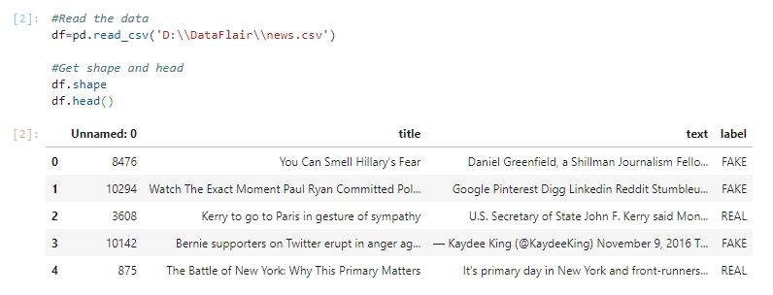
Importing Excel Dataset

Slide 10
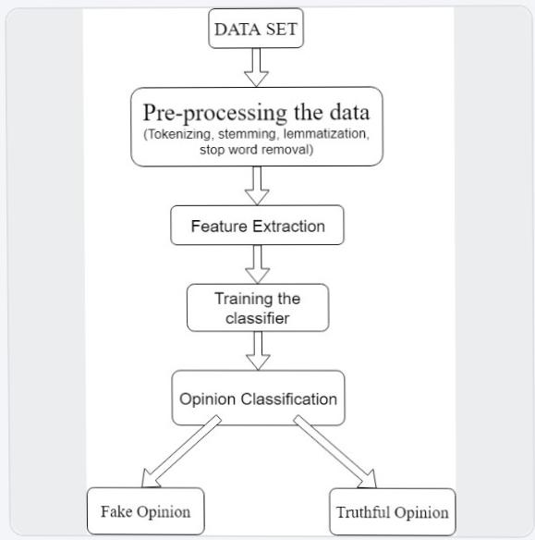
Process flow

Slide 11
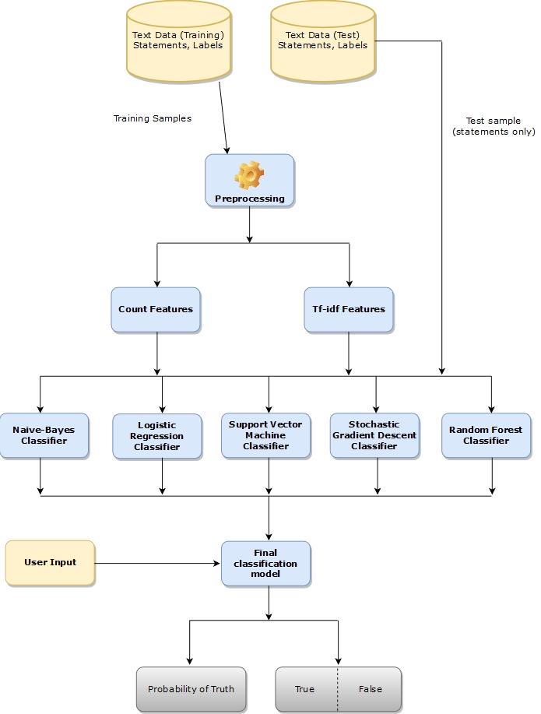

Slide 12
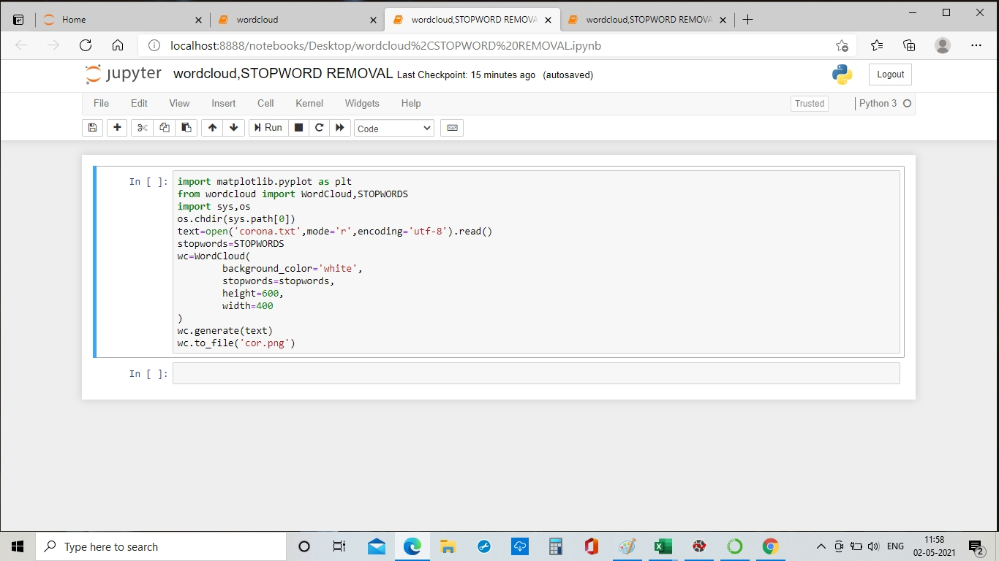
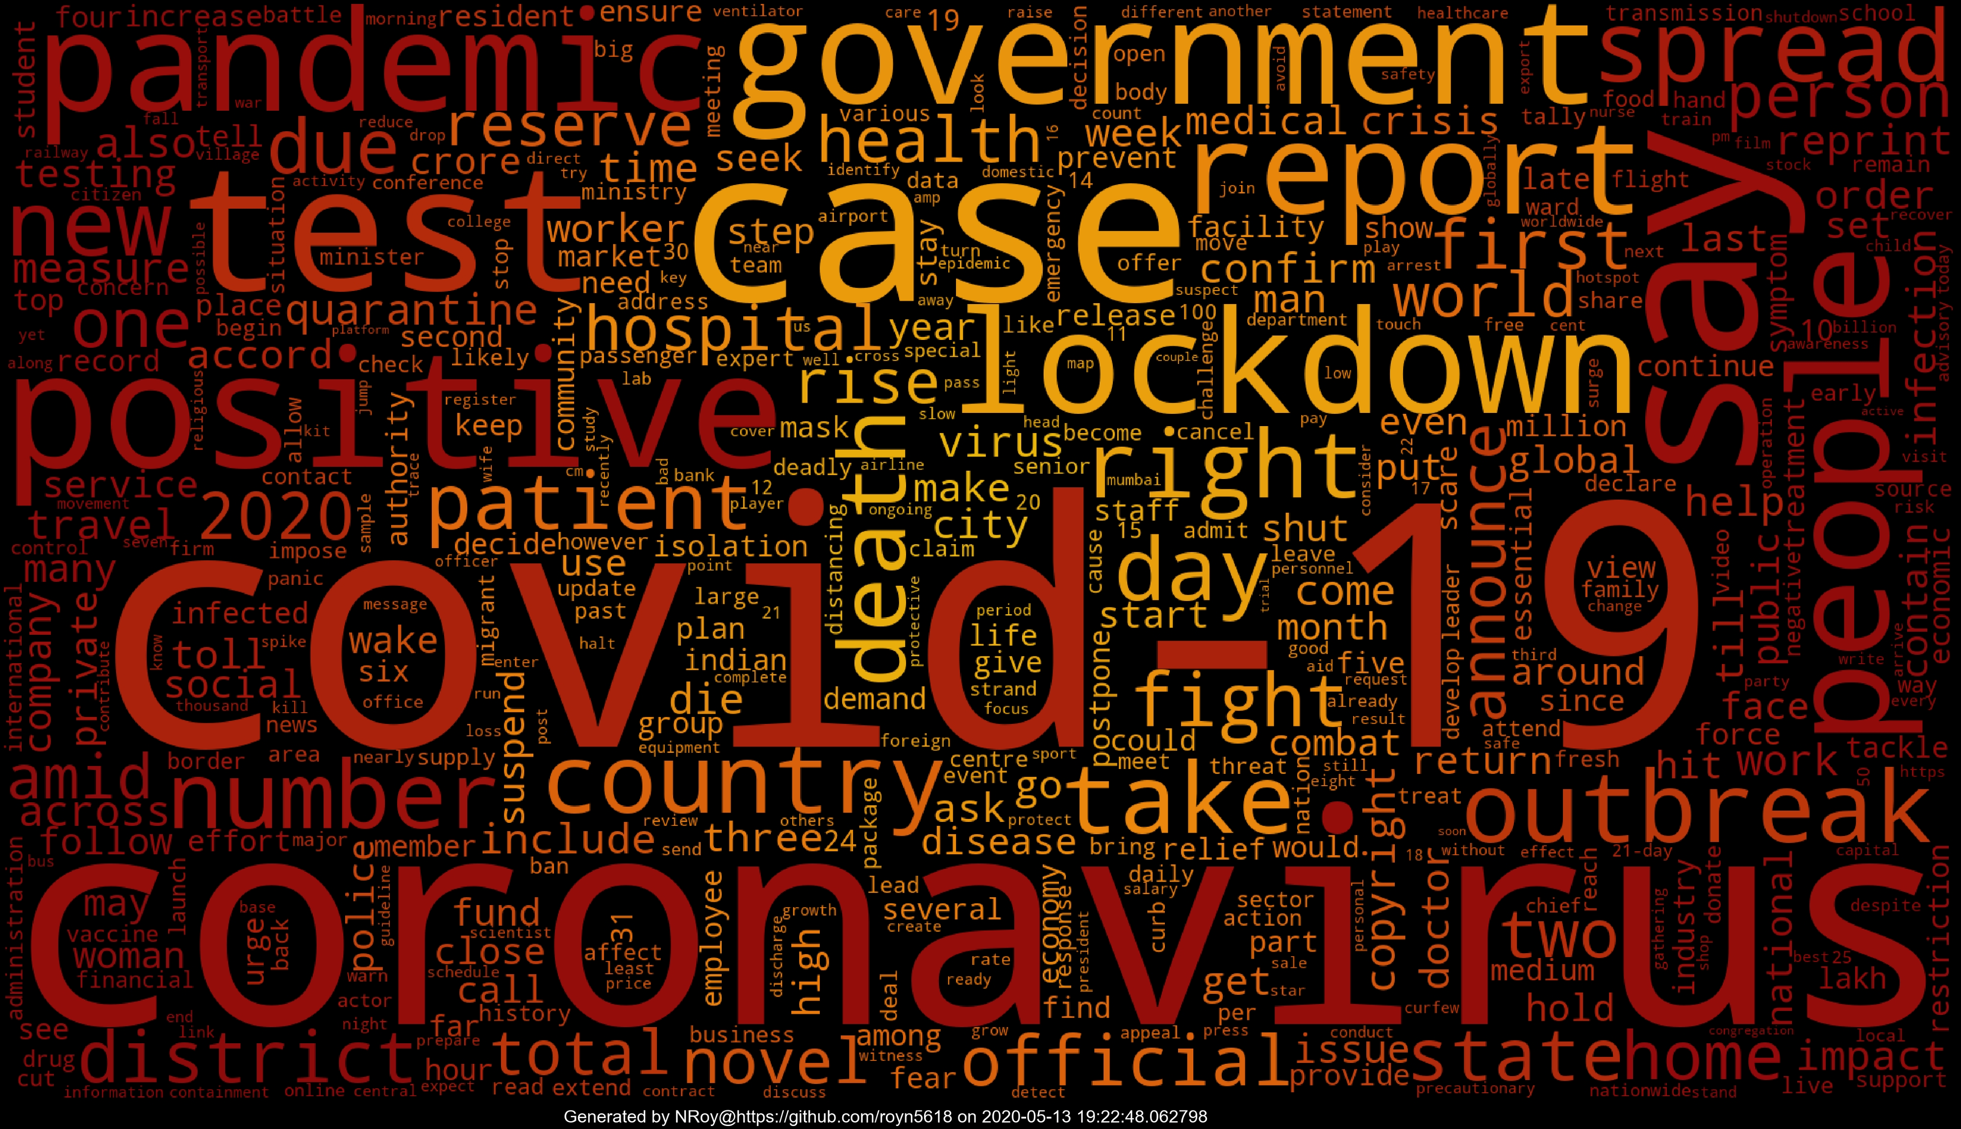
Data Preprocessing

Slide 13
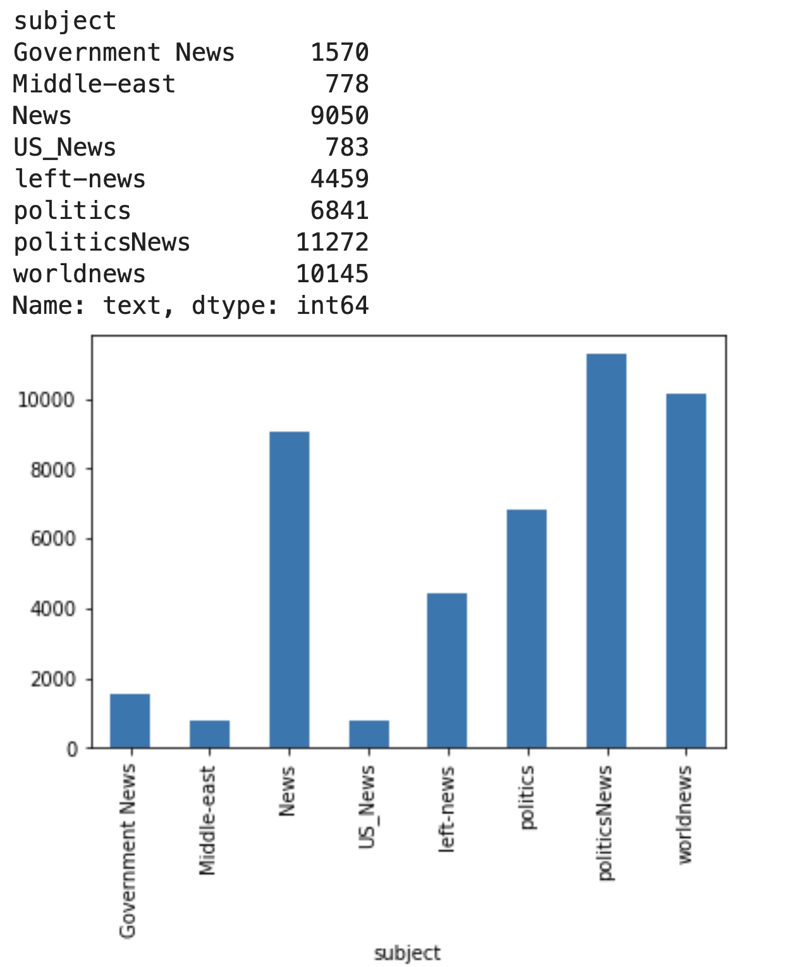
Graph

Slide 14
THANKS

